Slide 1
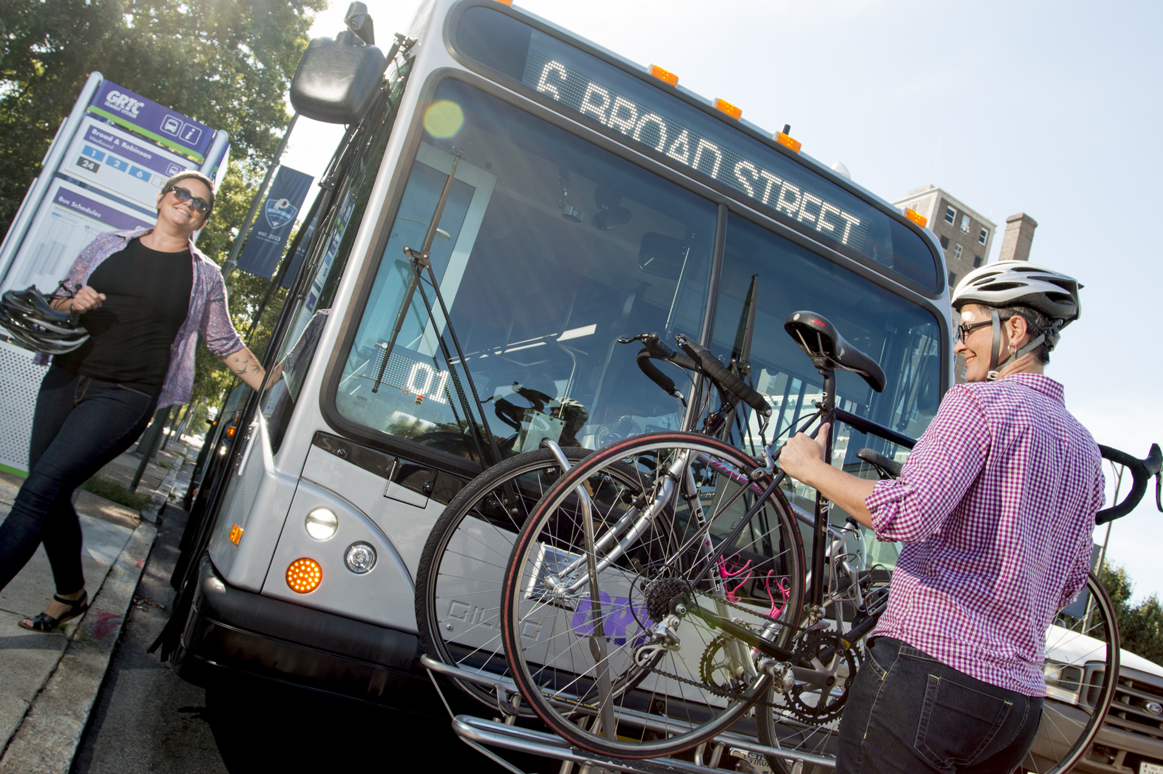
Sponsorship Opportunities

Slide 2
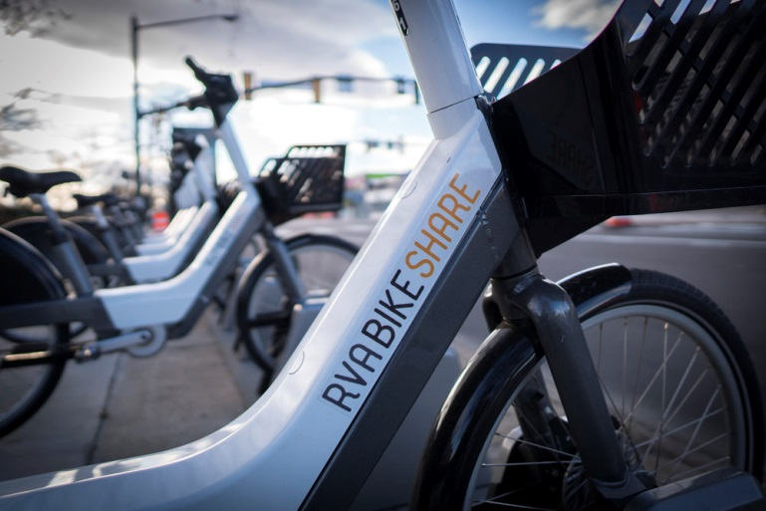
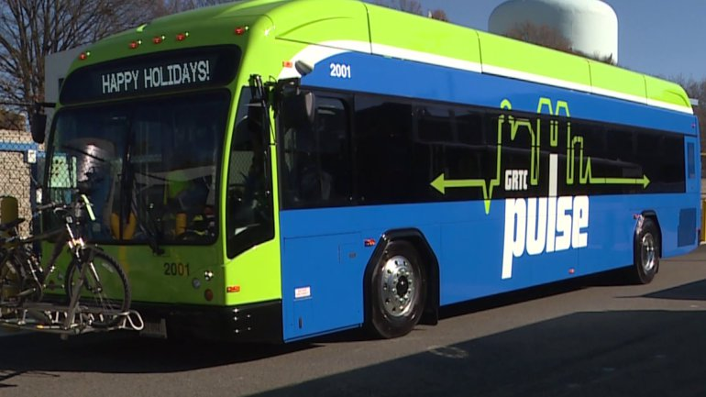
EVENT OVERVIEW
The hunt is on! The Pulse Pedal Pursuit is an all-day celebration of all things RVA, and our new public transit options! Scour the Broad Street corridor on foot, by RVA Bike Share, or by the brand new GRTC Pulse. We’ll provide the clues, all you need is a team (optional…you can go solo!), and a smart phone to document your journey. Go at your own pace, and meet us at the end of day at River City Roll to tally points, declare ultimate winners, and share stories from the day. Push through the Pursuit and the glory is yours!

Slide 3
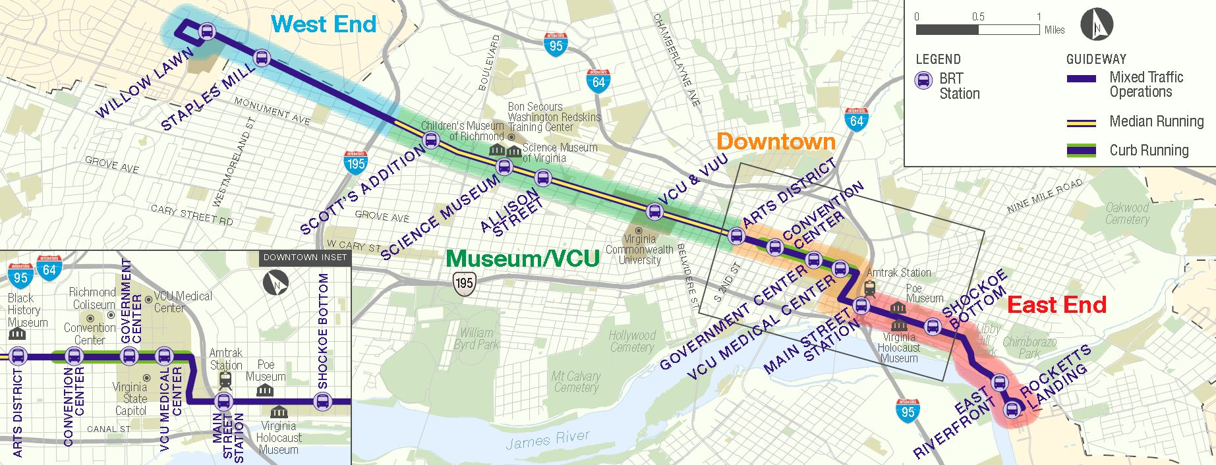
QUICK FACTS
What: Pulse Pedal Pursuit
Where: Start/Finish at River City Roll
Course will run from Willow Lawn to Rocketts Landing along the Broad Street Corridor
Date: Saturday, July 21st
Time: 9am to 5pm
Who: 650 expected participants
Event Charity: RVA Rapid Transit’s mission is to educate, organize, and advocate for a first-class public transit system across metro Richmond.

Slide 4
HOW DOES IT WORK?
Participants will have from 9am to 5pm on Saturday, July 21st to try to collect as many points as possible by visiting various sites in and around the new GRTC Pulse: Bus Rapid Transit route. This 7.6 mile route along Broad Street and Main Street covers all sorts of cool stops, and links many must see destinations throughout our city from Willow Lawn to Rocketts Landing.
Sites will include restaurants, breweries, art and history destinations, parks, and more! Participants will be given a list of these sites at packet pick-up at River City Roll (so no pre-visiting sites ☺) that will be grouped into five zones based on neighborhoods and bus stops along the route. Each site will be assigned a point value and participants will have the opportunity to earn bonus points by hitting a certain number of spots in each zone as well as by answering trivia questions at some of our highlighted destinations.
Participants can go for speed or keep it casual, but they are only allowed to get around by using their feet for walking and running or by using our two new transit options: RVA Bike Share and Pulse.
Since there won’t be any event officials or referees checking participants in at each of the sites, they must document their adventure with photos at each of the spots they hit – selfies welcomed and encouraged. Participants will bring these back with them to River City Roll, we will tally points, and determine winners. By the time participants are done, they will have learned how to use Pulse, Bike Share, and found some cool, fun places to explore in the future!

Slide 5
PREMIER SPONSOR ASSETS
Pre-Event Exposure
Company name and/or logo will be prominently featured on:
All print collateral
All recruitment emails (50,000 unique emails)
All social media accounts promoting the event including Facebook, Instagram, and Twitter
Pulse Pedal Pursuit website with linkage opportunity to company’s website
Opportunity to place a promotional message in e-newsletters forwarded to all participants
Opportunity to strengthen brand awareness through social media contest and promotions on the event Facebook page
On-Site Exposure
Company logo included on participant item
Company logo included on event signage
Company logo included on event map and site list
Opportunity to serve as a highlighted destination offering bonus points to participants that visit your destination
Opportunity to provide branded promotional items at the start/finish area to registered participants
Five free entries to promote associate participation
Investment
Investment of $2,500 to serve as a premier sponsor of the Pulse Pedal Pursuit

Slide 6
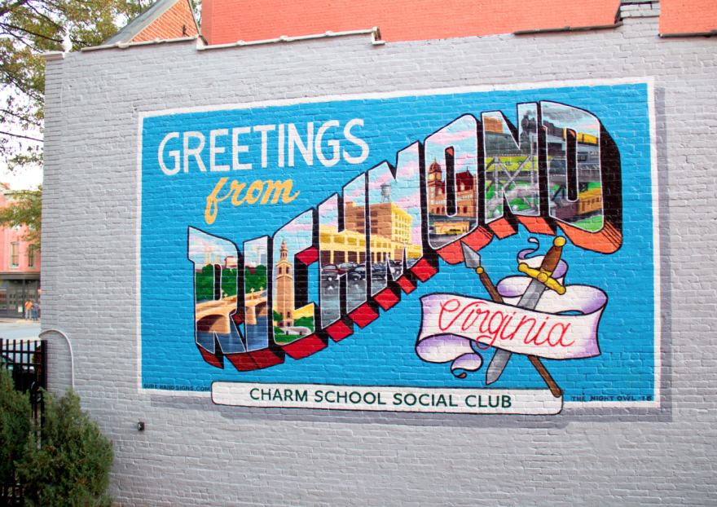
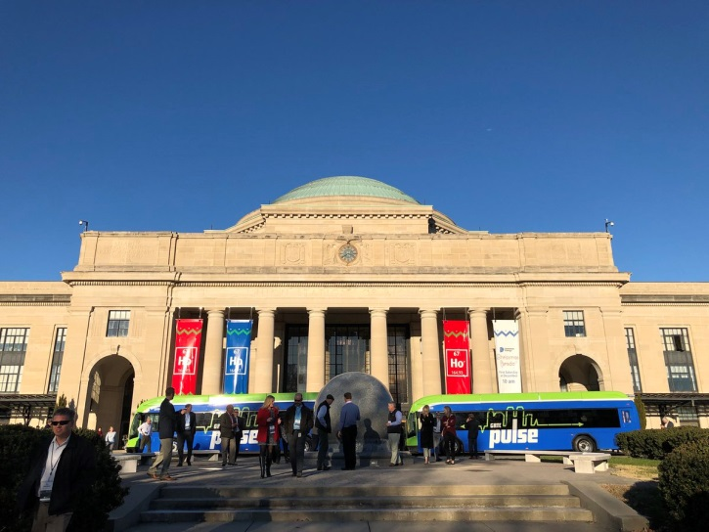
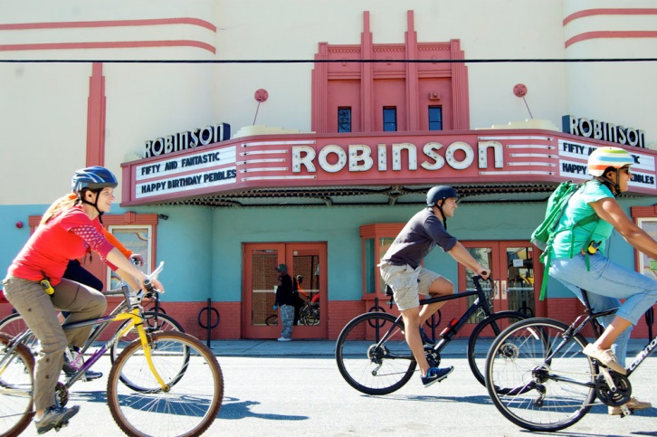
HIGHLIGHTED DESTINATION ASSETS
On-Site Exposure
Company location will serve as a “must visit” destination for participants
Opportunity for bonus points at company location
Company logo included on event signage
Company logo included on event map and site list, highlighting your organization as a must visit
Opportunity to provide branded promotional items at the start/finish area to registered participants
Investment
Investment of $500 to serve as a highlighted destination of the Pulse Pedal Pursuit

Slide 7
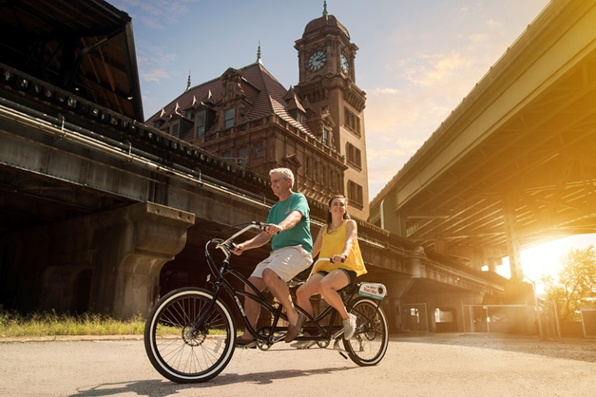
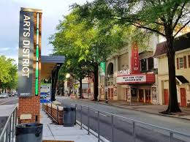
CONTACT
Will Dixon Sponsorship and Development Director
will@sportsbackers.org
Lauren Millard Sponsorship Manager lauren@sportsbackers.org
Mailing Address:
100 Avenue of Champions, Suite 300 Richmond, VA 23230
Phone Number
804-285-9495

